Slide 1

Unit-4 Number System and Units of Measurement
Indian Knowledge System
#2301DU005
Prof. Deepraj K. Patadia
Civil Engineering Department
deepraj.patadia@darshan.ac.in
7990475865

Slide 2

Looping
Number System and Units of Measurement
Base Number, Sub-base Number
Purak Anka (Complement of the Number)
Beejanka (Digital root)
Vinculum Number
Methods to find LCM and HCF
Ancient units for measurements
Modern units of measurement

Slide 3
Base Number and Sub base Number

Slide 4
Base Number
The term ‘base’ in Vedic Math has a broader meaning than you may be used to.
We work in a base 10 number system, but within Vedic Math, the ‘base’ is the number you will use as a basis for calculation.
The numbers taken can be either less or more than the base considered.
The difference between the number and the base is termed as deviation.
Deviation may be positive or negative.

Slide 5
Base Number
Number
Base
Number
–
Base
Deviation
13
10
13
−
10
3
7
10
7
−
10
−
3
89
100
89
−
100
−
11
1110
1000
1110
−
1000
110
99998
100000
99998
−
100000
−
2

Slide 6
Sub-Base Number
In Vedic Mathematics, a sub-base number is used to simplify calculations, especially in multiplication and division.
The sub-base is typically a multiple of the base number, which is often a power of 10 (like 10, 100, 1000, etc.).
The base is a number close to the multiplied or divided numbers.
The sub-base is a multiple of this base.
For example, if the base is 10, a sub-base could be 20, 30 etc.

Slide 7
Base Number
In today’s society, our knowledge of numbers has grown so much that we have multiple number systems.
A number base is the number of digits in a given counting system.
In the standard decimal base (in the standard base-10 number system), we have ten digits: 0, 1, 2, 3, 4, 5, 6, 7, 8, and 9.
in the octal system (that is, in the base-8 system), there are only eight digits: 0, 1, 2, 3, 4, 5, 6, and 7.
There is no digit "8" in the octal system.

Slide 8
Base Number
in the hexadecimal system (i.e., in the base-16 system), there are sixteen digits: 0 through 9, followed by A, B, C, D, E, and F.
Binary system are numbers that are written in the binary, or base-two, number system.
The only digits in the binary system are 0 and 1.

Slide 9
Base Number
Summary:
In math, a base number (or radix) defines how many unique digits a system uses. For example:
Base 10 (decimal) uses digits 0–9.
Base 2 (binary) uses 0 and 1.
Base 16 (hexadecimal) uses 0–9 and A–F.
A sub-base number refers to smaller divisions within the base, like tenths or hundredths in base 10 (e.g., 0.45 is 45/100).
In short, the base tells you the number system, and the sub-base helps with fractional parts.

Slide 10
Purak Anka (પૂરક અંક​)

Slide 11
Purak Anka
The Sanskrit word “purak” which means “to complement”.
Number when added to the complement, completes the base number.
Example: Purak of 1, 2, 3 ..... 8, 9 from 10 is 9, 8, 7,..... 2, 1
The Sutra “Nikhilam Navatashcaramam Dashatah” use for finding Purak Anka.
Meaning of sutra: All from 9 and last from 10.

Slide 12
Procedure to find Purak Anka
If right most digits are zeros, retain them.
Subtract non zero right most digit from 10.
Subtract all other digits(digits on higher places to step 2) from 9.

Slide 13
Example of Purak Anka
Example:
Find the Purak Anka number of 9862 with respect to base 10.
Solution:
All from 9 and Last from 10
9
10
9 8 6 2
0
1
3
8
Therefor, Purak Anka number of 9862 is 138.

Slide 14
Example of Purak Anka
Example:
Find the Purak Anka number of 7540 with respect to base 10.
Solution:
All from 9 and Last from 10
9
10
7 5 4 0
2
4
6
0
Therefor, Purak Anka number of 7540 is 2460

Slide 15
Example of Purak Anka
Example:
Find the Purak Anka number of 654 in Octal base system.
Solution:
Here, All from 7 and Last from 8
7
8
6 5 4
1
2
4
Therefor, Purak Anka number of 654 is 124

Slide 16
Example of Purak Anka
Summary:
In Vedic Maths, Pūrak Anka (complementary numbers) is linked to the sutra "Nikhilam Navatashcaramam Dashatah" ("All from 9 and the last from 10"). This simplifies subtraction and multiplication:
For subtraction, use the 9’s or 10’s complement.
Example: To subtract 456 from 1000, find the complement (544) and subtract easily.
For multiplication, complements help when numbers are near powers of 10.
This method speeds up calculations in Vedic Mathematics.

Slide 17
Example of Purak Anka
Here’s an example of using the Vedic Math, Nikhilam Sutra ("All from 9 and the last from 10") for multiplication of numbers near powers of 10:
Example: Multiply 98 × 97
Both numbers are close to 100 (a power of 10).
Step 1: Find the deficiencies of each number from 100.
98 is 2 less than 100, so the deficiency is -2.
97 is 3 less than 100, so the deficiency is -3.
Step 2: Subtract crosswise (one number from the other’s base complement).
98 – 3 = 95 or 97 – 2 = 95 (you’ll get the same result).
This method simplifies multiplication when numbers are near powers of 10.

Slide 18
Example of Purak Anka
Step 3: Multiply the deficiencies (the two negative numbers).
(-2) × (-3) = 6.
Step 4: Combine the results:
The answer is 9506.
So, 98×97=9506

Slide 19
Beejanka (બીજાંક​)

Slide 20
Beejanka
The Beejanka, also known as Navasesh, Digital Root, or "casting out nines“
The Beejanka of a number, is the sum of the digits in a number.
The Beejanka is a simple but very effective technique for checking the correctness of an answer.
use the Beejanka to check the result of arithmetic operations like addition, subtraction, multiplication, and division.
The correctness of any arithmetic operation can be verified by carrying out the same operation on the Beejanka of the numbers in the operation.

Slide 21
Beejanka (Basic Method)
The way to compute the Beejanka is to:
Find the sum of the digit
If the answer obtained is a single digit then that answer is the Beejanka.
(If the sum is 0 or 9 the Beejanka is 0)
If there is more than one digit in the answer, all the new digits are added together.
If the new answer obtained is a single digit then this is the Beejanka.
Otherwise, we keep repeating until a single digit is found, which will then be the Beejanka.

Slide 22
Beejanka (Enhanced Basic Method)
If 9 is added or subtracted from any number, Beejanka remains unaffected.
It is this property of 9 that can help us quickly find the Beejanka of any number.
By quickly canceling all 9's or the digits summing to 9 from the number whose Beejanka we require.

Slide 23
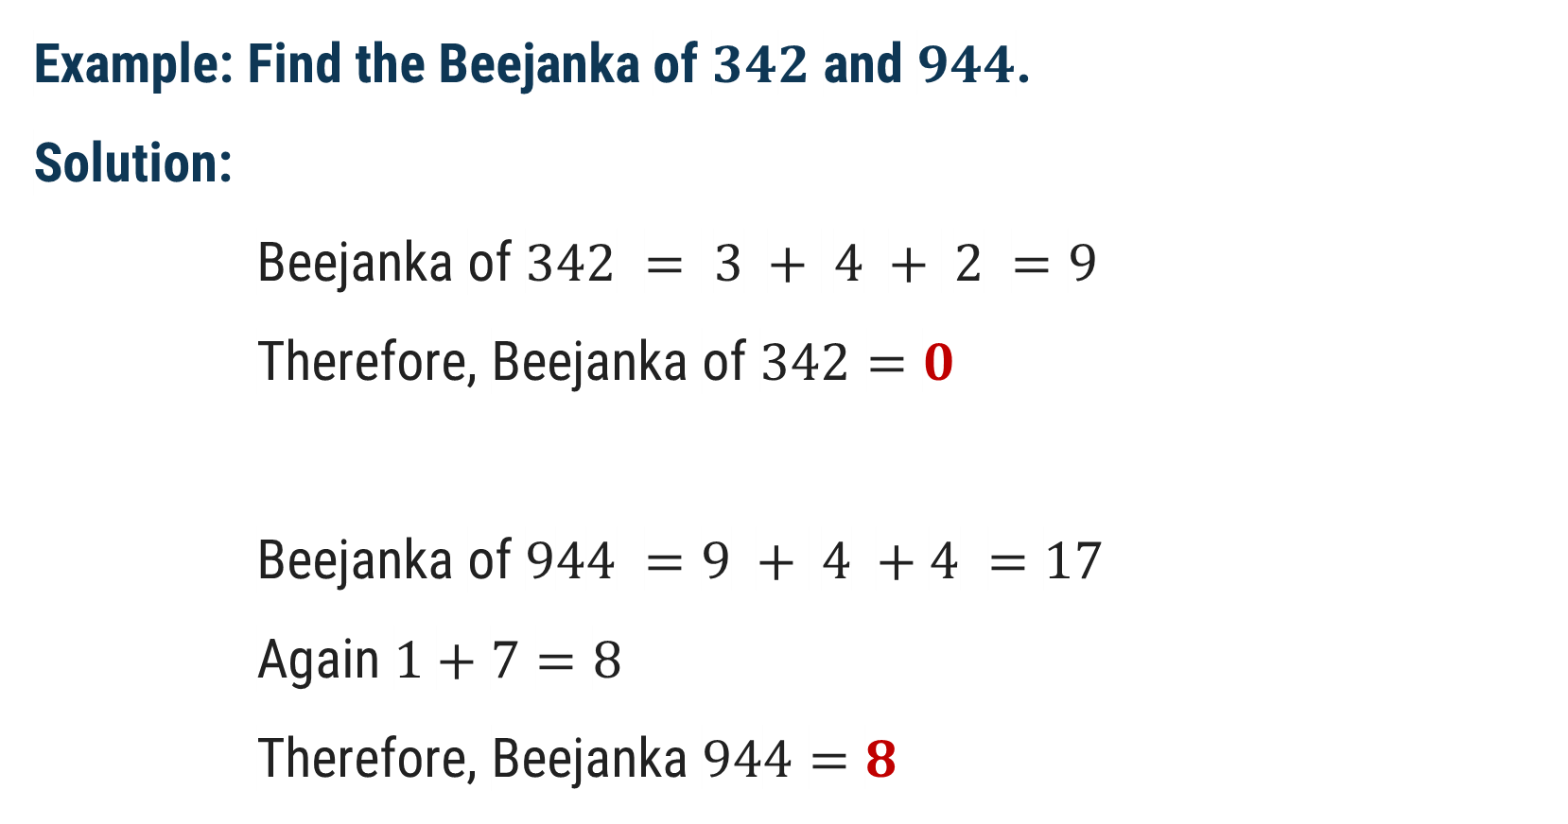
Example of Beejanka
Example: Find the Beejanka of $342$ and $944$.
Solution:
Beejanka of $342 = 3 + 4 + 2 =9$
Therefore, Beejanka of $342=0$
Beejanka of $944 =9 + 4 +4 =17$
Again $1+7=8$
Therefore, Beejanka $944=8$

Slide 24
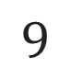
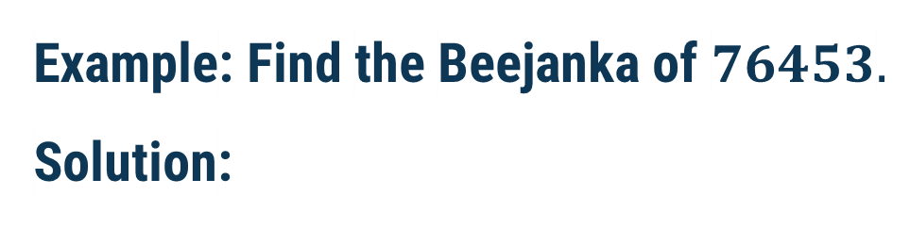
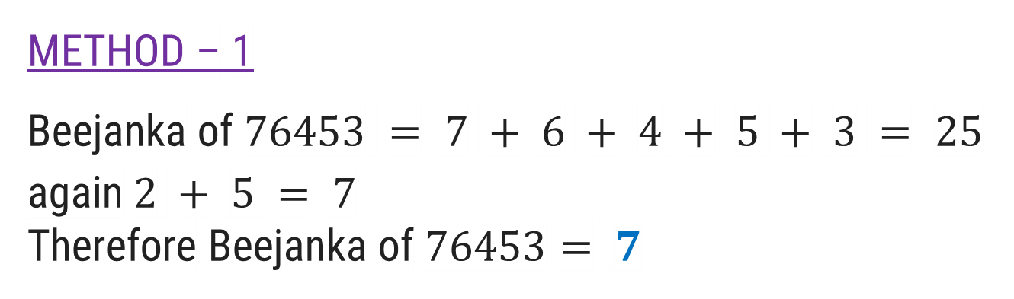
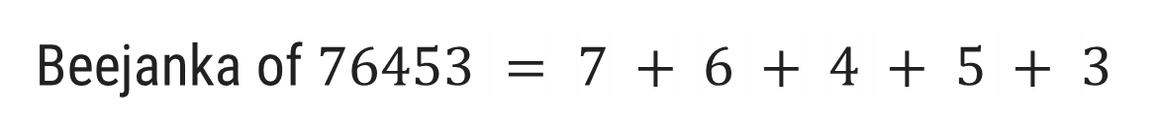
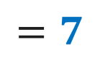
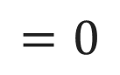

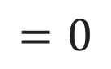
Example of Beejanka
Example: Find the Beejanka of $76453.$
Solution:
METHOD – 1
Beejanka of $76453 = 7 + 6 + 4 + 5 + 3 = 25$
again $2 + 5 = 7$
Therefore Beejanka of $76453= 7$
METHOD – 2
$$9$$
$$=0$$
Beejanka of $76453 = 7 + 6 + 4 + 5 + 3$
$$=7$$
$$9$$
$$=0$$

Slide 25
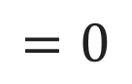
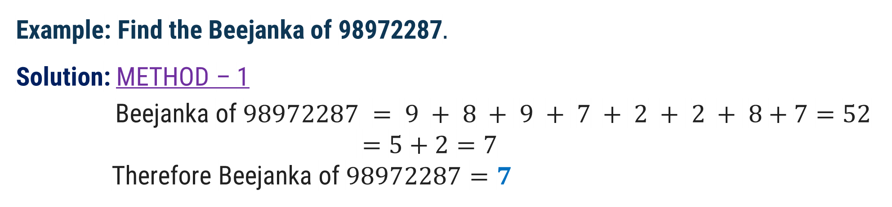
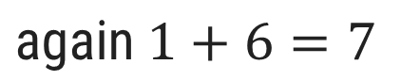
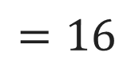
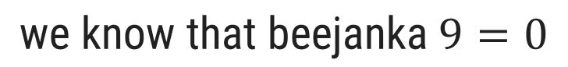
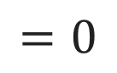
Example of Beejanka
Example: Find the Beejanka of 98972287$.$
Solution: METHOD – 1
Beejanka of $98972287 = 9 + 8 + 9 + 7 + 2 + 2 + 8+7=52$
$=5+2=7$
Therefore Beejanka of $98972287=7$
METHOD – 2
$$\text{we} \text{know} \text{that} \text{beejanka} 9=0$$
$$=0$$
$$=0$$
Beejanka of $98972287 =9+8+9+7+2+2+8+7$
$$=16$$
$$\text{again} 1+6=7$$
$$\text{Therefore} \text{Beejank}\text{a} \text{of}\text{ 98972287}=7$$

Slide 26
Beejanka
Summary:
Beejanka (बीजांक), or digit root, is a concept in Vedic Mathematics used to simplify and verify calculations. It involves summing the digits of a number repeatedly until a single-digit number (1-9) is obtained.
How to Calculate Beejanka:
For 456:
Sum of digits: 4 + 5 + 6 = 15
Sum of 15: 1 + 5 = 6
Beejanka of 456 = 6.

Slide 27
Beejanka
Application in Operations:
Addition Example:
For 456 + 789:
Beejanka of 456 = 6
Beejanka of 789 = 6
Beejanka of 1245 (result): 1 + 2 + 4 + 5 = 12 → 1 + 2 = 3
Final check: Beejanka matches the result.
Multiplication Example:
For 25 × 37:
Beejanka of 25 = 7
Beejanka of 37 = 1
Product 925: Beejanka = 9 + 2 + 5 = 16 → 1 + 6 = 7
Final check: Beejanka of product = 7.

Slide 28
Vinculum Number

Slide 29
Vinculum Number
Vinculum means bar(line) present over the symbol/digit.
Sanskrit Name: विनक्ल्म्
Vinculum Numbers is concept used in Vedic Mathematics and are those numbers which have at least 1 digit which is negative (having bar over them). Also called as Bar Numbers.
In other words, Vinculum Numbers is nothing but the mixture of positive digit and negative digit in same number.
Negative number having bar over them.

Slide 30
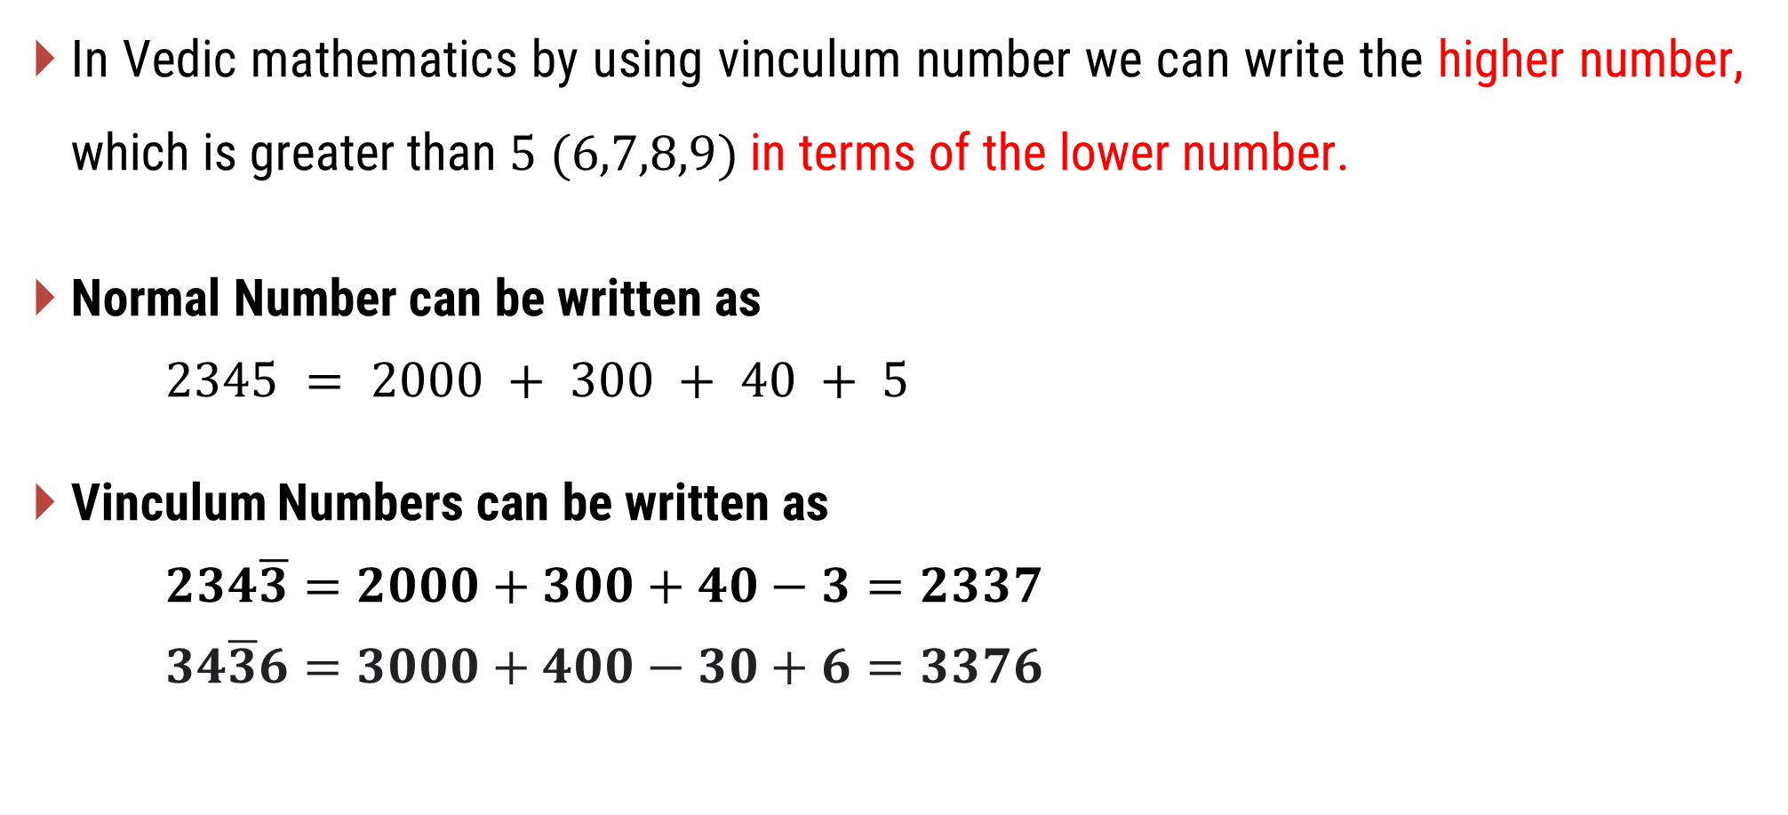
Vinculum Number
In Vedic mathematics by using vinculum number we can write the higher number, which is greater than $5 (6,7,8,9)$in terms of the lower number.
Normal Number can be written as
$2345 = 2000 + 300 + 40 + 5$
Vinculum Numbers can be written as
$234\overline{3}=2000+300+40−3=2337$
$34\overline{3}6=3000+400−30+6=3376$

Slide 31
Vinculum Number
Usage:
Vinculum numbers are used especially whenever we have higher digits (6, 7, 8, 9) in a number for carrying out Subtraction, Multiplication, Division, etc. Like any other number, the Vinculum Number is a hypothetical number used in Vedic Mathematics to make calculations faster.

Slide 32
Conversion (Vinculum to Normal, Normal to Vinculum)
For conversion, Vinculum number to Normal number
Sutra: “Nikhilam Navatashcharamam Dashatsh”
Meaning: all from 9 and last from 10
For conversion, Normal number to Vinculum number
Sutra: “Ekadhikena Purvena”
Meaning: One more than the previous

Slide 33
Conversion (Vinculum to Normal)
Procedure for converting Vinculum Number to Normal Number:
(apply from right to Left)
Find the 1st Bar digit, and take its 10’s complement.
(a) If the next digit is again a Bar digit, take its 9’s complement
and continue (a) until a non-bar digit is obtained.
(b) Decrement of the non-bar digit by 1.
Continue (1) and (2) till the complete number is covered.

Slide 34

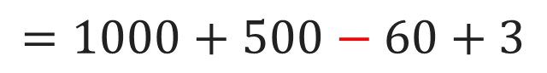
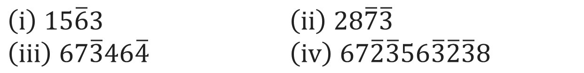

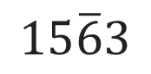
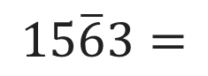

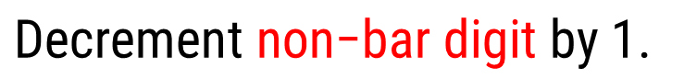

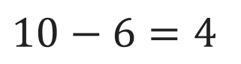
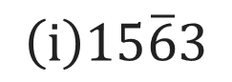
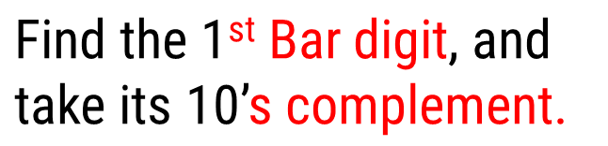
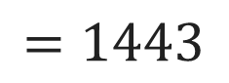
Example of Vinculum to Normal
Example
Convert the following vinculum Number into Normal Number
$\left(i\right) 15\overline{6}3$ $\left(ii\right) 28\overline{7}\overline{3}$
$\left(iii\right) 67\overline{3}46\overline{4}$ $\left(iv\right) 67\overline{2}\overline{3}56\overline{3}\overline{2}\overline{3}8$
Solution
$$\left(i\right)15\overline{6}3$$
$$15\overline{6}3$$
$$=1000+500−60+3$$
$$=1443$$
$$\text{Find} \text{the}\text{ 1}\text{st} \text{Bar} \text{digit}\text{, }\text{and}$$
$$\text{take} \text{its}\text{ 10’}\text{s} \text{complement}\text{.}$$
OR
$$10−6=4$$
$$15\overline{6}3=$$
$$1$$
$$4$$
$$4$$
$$3$$
$$\text{Decrement} \text{non}\text{−}\text{bar} \text{digit} \text{by}\text{ 1}\text{.}$$

Slide 35

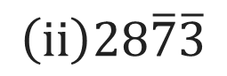

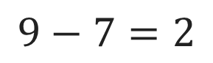
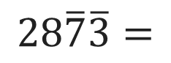


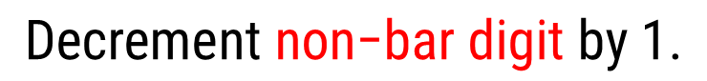

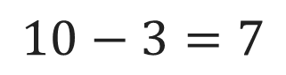
Example of Vinculum to Normal
$$\left(ii\right)28\overline{7}\overline{3}$$
$\text{Find} \text{the}\text{ 1}\text{st} \text{Bar} \text{digit}\text{, }\text{and} \text{take} \text{its}\text{ 10’}\text{s} \text{complement}$.
$$10−3=7$$
$$28\overline{7}\overline{3}=$$
$$2$$
$$7$$
$$2$$
$$7$$
$\text{If} \text{the} \text{next} \text{digit} \text{is} \text{again} \text{a} \text{Bar} \text{digit}\text{, }\text{take} \text{its}\text{ 9’}\text{s} \text{complement}$.
$$9−7=2$$
$$\text{Decrement} \text{non}\text{−}\text{bar} \text{digit} \text{by}\text{ 1}\text{.}$$

Slide 36

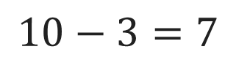
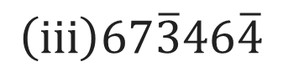


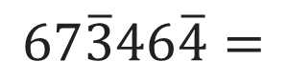



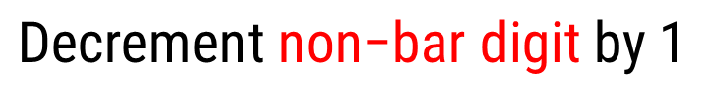

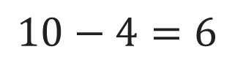

Example of Vinculum to Normal
$$\left(iii\right)67\overline{3}46\overline{4}$$
$\text{Find} \text{the}\text{ 1}\text{st} \text{Bar} \text{digit}\text{, }\text{and} \text{take} \text{its}\text{ 10’}\text{s} \text{complement}$.
$$10−4=6$$
$$67\overline{3}46\overline{4}=$$
$$6$$
$$6$$
$$7$$
$$4$$
$$5$$
$$6$$
$$\text{If} \text{the} \text{next} \text{digit} \text{is} \text{again} \text{a} \text{Bar} \text{digit}\text{, }\text{take} \text{its}\text{ 9’}\text{s} \text{complement}\text{.}$$
$$\text{Decrement} \text{non}\text{−}\text{bar} \text{digit} \text{by}\text{ 1}$$
Repeat all above steps
$$\text{Find} \text{the}\text{ 1}\text{st} \text{Bar} \text{digit}\text{, }\text{and} \text{take} \text{its}\text{ 10’}\text{s} \text{complement}\text{.}$$
$$10−3=7$$
$$\text{If} \text{the} \text{next} \text{digit} \text{is} \text{again} \text{a} \text{Bar} \text{digit}\text{, }\text{take} \text{its}\text{ 9’}\text{s} \text{complement}\text{.}$$
$$\text{Decrement} \text{non}\text{−}\text{bar} \text{digit} \text{by}\text{ 1}$$

Slide 37

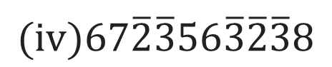
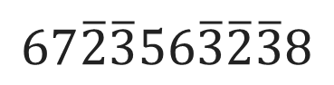
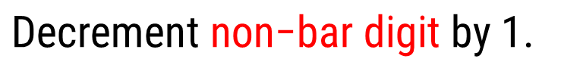
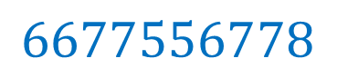
Example of Vinculum to Normal
$$(iv)67\overline{2}\overline{3}56\overline{3}\overline{2}\overline{3}8$$
$$\text{Find} \text{the}\text{ 1}\text{st} \text{Bar} \text{digit}\text{, }\text{and} \text{take} \text{its}\text{ 10’}\text{s} \text{complement}\text{.}$$
$$\text{If} \text{the} \text{next} \text{digit} \text{is} \text{again} \text{a} \text{Bar} \text{digit}\text{, }\text{take} \text{its}\text{ 9’}\text{s} \text{complement}\text{.}$$
$$67\overline{2}\overline{3}56\overline{3}\overline{2}\overline{3}8$$
$$\text{Decrement} \text{non}\text{−}\text{bar} \text{digit} \text{by}\text{ 1}\text{.}$$
$$=$$
$$6677556778$$
Repeat above steps.

Slide 38
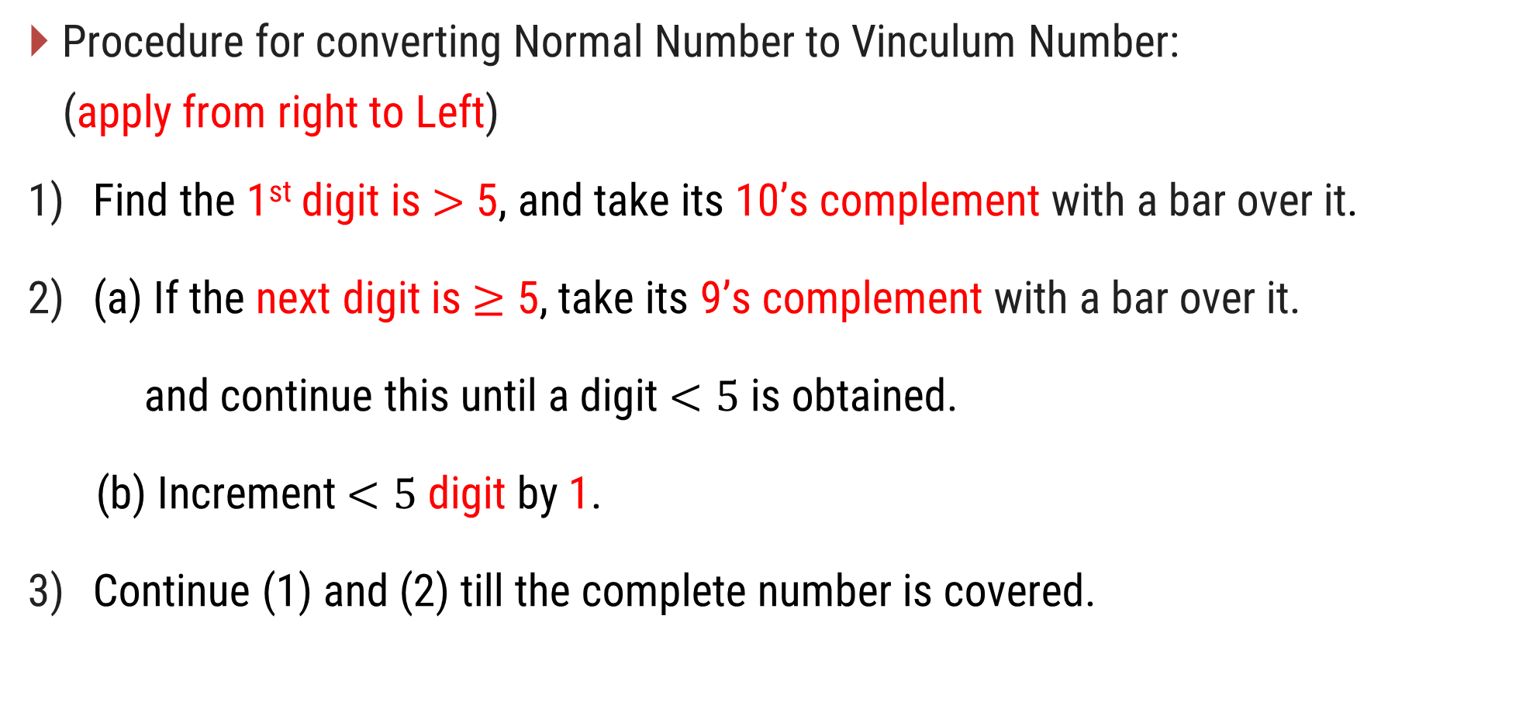
Conversion (Normal to Vinculum)
Procedure for converting Normal Number to Vinculum Number:
(apply from right to Left)
Find the 1st digit is $>$ 5, and take its 10’s complement with a bar over it.
(a) If the next digit is $≥$ 5, take its 9’s complement with a bar over it.
and continue this until a digit $<5$ is obtained.
(b) Increment $<5$ digit by 1.
Continue (1) and (2) till the complete number is covered.

Slide 39
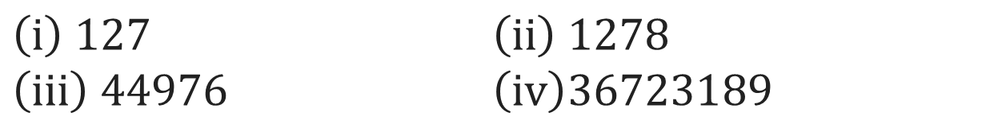
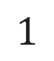
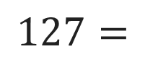
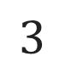
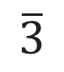
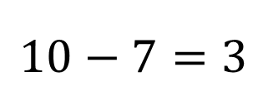
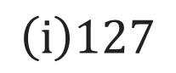

Example of Normal to Vinculum
Example
Convert the following Normal Number into Vinculum Number.
$\left(i\right) 127$ $\left(ii\right) 1278$
$\left(iii\right) 44976$ $\left(iv\right)36723189$
Solution
$$\left(i\right)127$$
$$127=$$
$$1$$
$$3$$
$$\overline{3}$$
Find the $1$^{st} digit is $>$ $5$, and take its $10$’s complement with a bar over it.
$$10−7=3$$
$$\text{Increment} <5 \text{digit} \text{by} 1.$$

Slide 40
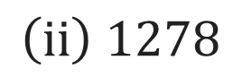

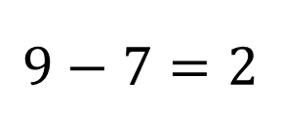
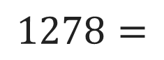

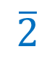



Example of Vinculum to Normal
$$\left(ii\right) 1278$$
$$1278=$$
$$1$$
$$3$$
$$\overline{2}$$
$$\overline{2}$$
Find the $1$^{st} digit is $>$ $5$, and take its $10$’s complement with a bar over it.
$$10−8=2$$
If the next digit is $≥$ $5$, take its $9$’s complement with a bar over it.
$$9−7=2$$
$$\text{Increment} <5 \text{digit} \text{by} 1.$$

Slide 41










Example of Vinculum to Normal
$$\left(iii\right) 44976$$
$$44976=$$
$$4$$
$$5$$
$$\overline{0}$$
$$\overline{2}$$
$$\overline{4}$$
Find the $1$^{st} digit is $>$ $5$, and take its $10$’s complement with a bar over it.
$$10−6=4$$
If the next digit is $≥$ $5$, take its $9$’s complement with a bar over it.
$$9−7=2$$
$$9−9=0$$
$$\text{Increment} <5 \text{digit} \text{by} 1.$$

Slide 42















Example of Vinculum to Normal
$$\left(iv\right) 36723189$$
$$4$$
$$\overline{3}$$
$$\overline{3}$$
$$2$$
$$3$$
$$2$$
$$\overline{1}$$
$$36723189=$$
$$\overline{1}$$
Find the 1st digit is $>$ 5, and take its 10’s complement with a bar over it.
$$10−9=1$$
$$10−7=3$$
If the next digit is $≥$ 5, take its 9’s complement with a bar over it.
$$9−8=1$$
$$9−6=3$$
$$\text{Increment} <5 \text{digit} \text{by}\text{ 1}\text{.}$$

Slide 43

Methods to Find LCM and HCF

Slide 44
Methods to Finding HCF
Euclidean Algorithm:
Historical Context: Although the Euclidean Algorithm is traditionally attributed to the Greek mathematician Euclid, ancient Indian mathematicians like Aryabhata and Brahmagupta employed similar iterative division methods.
Method:
Divide the larger number by the smaller number to get a quotient and remainder.
Replace the larger number with the smaller number and the smaller number with the remainder.
Repeat until the remainder is zero. The last non-zero remainder is the HCF.

Slide 45
Methods to Finding HCF
Brahmagupta’s Rules:
Description: In his work "Brahmasphutasiddhanta," Brahmagupta described methods for solving problems that involve divisors and remainders, which are related to finding HCF.
Procedure:
Brahmagupta's rules involved solving equations of the form ax+by=d where d is the HCF of a and b. This methods for handling divisions and remainders implicitly dealt with HCF.

Slide 46
Methods to Finding HCF and LCM
Prime Factorization:
Historical Context: Indian mathematicians used prime factorization techniques, although the formalization of the method evolved over time.
Method:
Factorize each number into its prime components.
For HCF: Take the lowest power of each common prime factor.
For LCM: Take the highest power of each prime factor appearing in the factorizations.
Application: Techniques used in solving problems related to fractions and divisibility reflect an understanding of prime factors.

Slide 47

Methods to Finding LCM
Applications in Astronomy:
Historical Context: Although the explicit formula might not have been stated in ancient texts, the use of HCF to determine multiples was understood through problem-solving approaches involving common periods and synchronization.
Method:
The LCM of two numbers can be found using their HCF. The relationship between HCF and LCM for two numbers a and b is given by:
$$LCM\left(a,b\right)=\frac{a×b}{HCF(a,b)}$$

Slide 48
Ancient units for measurements

Slide 49
Ancient units for measurements
In ancient India, units of measurement were derived from practical and natural references, such as the human body, grains, and other observable phenomena.
These units were used for measuring length, weight, area, time, and volume.
The system was highly localized, but some standard units existed across regions, especially in trade and architecture.

Slide 50
Ancient units for measurements
The use of these measurement units can be traced back to the Indus Valley Civilization (3300–1300 BCE) and continued through the Vedic period (1500–500 BCE), the Maurya Empire (322–185 BCE), and later periods.
These units were documented in ancient texts such as the Arthashastra by Kautilya and various Vedic scriptures.

Slide 51
Units of Length
Unit | Value / Approximation | Usage
Angula (अङ्गुल) | 1 Angula ≈ ¾ inch (1.9 cm) | Small lengths (finger width)
Hasta (हस्त) | 1 Hasta = 24 Angulas ≈ 18 inches (45 cm) | Length of a hand or forearm
Dhanusha (धनुष) | 1 Dhanusha = 4 Aratnis ≈ 6 feet (182 cm) | Bow's length (longer distances)
Yojana (योजन) | 1 Yojana ≈ 8 to 9 miles (12 to 15 km) | Long distances (travel)
Krosa (क्रोश) | 1 Krosa ≈ 3,000 meters (3 km) | Land area or distance measure

Slide 52
Units of Weight
Unit | Value / Approximation | Usage
Ratti (रत्ती) | 1 Ratti ≈ 0.11 grams | Small weights (jewelry, seeds)
Masha (माष) | 1 Masha = 8 Rattis ≈ 0.9 grams | Weighing in trade and medicine
Tola (तोला) | 1 Tola = 12 Mashas ≈ 11.66 grams | Precious metals (gold, silver)
Ser (सेर) | 1 Ser = 80 Tolas ≈ 933 grams or ~1 kg | Trade in grains, groceries
Maund (मण) | 1 Maund = 40 Sers ≈ 37.3 kg | Large-scale trading of grains

Slide 53
Units of Area
Unit | Value / Approximation | Usage
Nivartana (निवर्तन) | 1 Nivartana ≈ 1.6 acres | Agricultural land measurement
Kulyavapa (कुल्यवाप) | 1 Kulyavapa ≈ 5 acres (varied) | Amount of land plowed in a day

Slide 54
Units of Volume
Unit | Value / Approximation | Usage
Prastha | 1 Prastha = 64 Tolas ≈ 768 grams (dry vol.) | Grains and dry volumes
Kumbha | 1 Kumbha ≈ 20 liters | Liquid measurements
Drona | 1 Drona = 100 Prasthas ≈ 80 kg of grain | Grain storage or volume

Slide 55
Units of Time
Unit | Value / Approximation | Usage
Kala (काल) | 1 Kala ≈ 48 seconds | Small units of time
Muhurta (मुहूर्त) | 1 Muhurta = 48 minutes | Daily timekeeping, rituals
Yuga (युग) | Krita Yuga = 1,728,000 years | Large cosmic cycles
 | Treta Yuga = 1,296,000 years
 | Dvapara Yuga = 864,000 years
 | Kali Yuga = 432,000 years
Ghatika (घटिका) | 1 Ghatika ≈ 24 minutes | Vedic time, astrology

Slide 56
Modern units for measurements

Slide 57
Modern units for measurements
The modern system of measurement widely used today is the International System of Units (SI) also known as the metric system.
It is the most widely used system of measurement globally.
It was established in 1960 by the General Conference on Weights and Measures (CGPM) and is maintained by the International Bureau of Weights and Measures (BIPM).
The SI system is designed to provide a consistent framework for measurements across various scientific, industrial, and everyday applications.

Slide 58
Modern units for measurements
Global Standardization
The SI system’s global adoption ensures that measurements are…
consistent and comparable worldwide.
facilitating international trade.
scientific research.
technological development.
It also helps avoid confusion and errors that can arise from using different measurement systems.

Slide 59
Base Units
The SI system is built on seven base units, each representing a fundamental physical quantity:
Meter (m): The unit of length.
Kilogram (kg): The unit of mass.
Second (s): The unit of time.
Ampere (A): The unit of electric current.
Kelvin (K): The unit of thermodynamic temperature.
Mole (mol): The unit of the amount of substance.
Candela (cd): The unit of luminous intensity.

Slide 60
Derived Units
The system can accommodate coherent units for an unlimited number of additional quantities. These are called coherent derived units.
Which can always be represented as products of powers of the base units.
Twenty-two coherent derived units have been provided with special names and symbols.

Slide 61
List of Derived Units
Name
Symbol
Quantity
SI base units
Other SI units
radian
rad
plane angle
m/m
1
steradian
sr
solid angle
m
2
/m
2
1
hertz
Hz
frequency
s
−1
newton
N
force
,
weight
kg
⋅
m
⋅
s
−2
pascal
Pa
pressure
,
stress
N/m
2
= J/m
kg
3
⋅
m
−1
⋅
s
−2
joule
J
energy
,
work
,
heat
kg
⋅
m
2
⋅
s
−2
N
⋅
m = Pa
⋅
m
3
watt
W
power
,
radiant flux
kg
J/s
⋅
m
2
⋅
s
−3

Slide 62
List of Derived Units
Name
Symbol
Quantity
SI base units
Other SI units
coulomb
C
electric charge
s
⋅
A
electric
volt
V
potential
W/A = J/C
,
voltage
,
kg
⋅
m
2
⋅
s
−3
⋅
A
−1
emf
farad
F
capacitance
C/V = C
2
kg
−1
/J
⋅
m
−2
⋅
s
4
⋅
A
2
resistance
,
ohm
Ω
impedance
,
kg
⋅
m
2
⋅
s
−3
⋅
A
−2
V/A = J
⋅
s/C
2
reactance
siemens
S
electrical conductance
Ω
kg
−1
−1
⋅
m
−2
⋅
s
3
⋅
A
2
weber
Wb
magnetic flux
kg
⋅
m
2
⋅
s
−2
⋅
A
−1
V
⋅
s

Slide 63
List of Derived Units
Name
Symbol
Quantity
SI base units
Other SI units
tesla
T
magnetic flux density
Wb/m
kg
2
⋅
s
−2
⋅
A
−1
henry
H
inductance
kg
Wb/A
⋅
m
2
⋅
s
−2
⋅
A
−2
temperature
degree Celsius
°
C
K
relative
to 273.15 K
lumen
lm
luminous flux
cd
⋅
m
2
/m
2
cd
⋅
sr
lm
/m
2
=
lux
lx
illuminance
cd
⋅
m
2
/m
4
cd
⋅
sr
⋅
m
−2
activity referred to a
Becquerel
Bq
s
radionuclide
−1
(decays per unit time)

Slide 64
List of Derived Units
Name
Symbol
Quantity
SI base units
Other SI units
absorbed
gray
Gy
dose
(
J/kg
of
ionising
m
2
⋅
s
−2
radiation
)
equivalent
sievert
Sv
dose
(
of
ionising
m
J/kg
2
⋅
s
−2
radiation
)
katal
kat
catalytic activity
mol
⋅
s
−1

Slide 65
SI prefixes
A unit prefix that precedes a basic unit of measure to indicate a multiple or submultiple of the unit.
All metric prefixes used today are decadic.
Each prefix has a unique symbol that is prepended to any unit symbol.
They help in expressing very large or very small quantities in a more manageable form.

Slide 66
List of SI prefixes
Name
Symbol
Quantity
quetta
Q
10
30
ronna
R
10
27
yotta
Y
10
24
zetta
Z
10
21
exa
E
10
18
peta
P
10
15
tera
T
10
12
giga
G
10
9
mega
M
10
6

Slide 67
List of SI prefixes
Name
Symbol
Quantity
kilo
k
10
3
hecto
h
10
2
deca
da
10
1
—
—
10
0
deci
d
10
−1
centi
c
10
−2
milli
m
10
−3
micro
μ
10
−6
nano
n
10
−9
pico
p
10
−12

Slide 68
List of SI prefixes
Name
Symbol
Quantity
femto
f
10
−15
atto
a
10
−18
zepto
z
10
−21
yocto
y
10
−24
ronto
r
10
−27
quecto
q
10
−30

Slide 69
Thank You
Indian Knowledge System
#2301DU005

